Slide 1

Workshop Data in use Protection Compass Keep the cape in the Cloud and on the Edge Introduction of the workshop
N
Version 1.0 (Alpha) – July 2020
https://aka.ms/DataInUseProtectionWS
Notes:
This presentation is shared under the license "Attribution 4.0 International (CC BY 4.0)". To see a copy of this license, visit https://creativecommons.org/licenses/by/4.0/legalcode or write to Creative Commons, PO Box 1866, Mountain View, CA 94042 USA
Microsoft, Windows, Microsoft Azure and/or other Microsoft products and services referenced in the documentation may be either trademarks or registered trademarks of Microsoft in the United States and/or other countries. The licenses for this project do not grant you rights to use any Microsoft names, logos, or trademarks. Microsoft's general trademark guidelines can be found at http://go.microsoft.com/fwlink/?LinkID=254653.
Privacy information can be found at https://privacy.microsoft.com/en-us/
Microsoft and any contributors reserve all other rights, whether under their respective copyrights, patents, or trademarks, whether by implication, estoppel or otherwise.
MICROSOFT AND ANY CONTRIBUTORS MAKE NO WARRANTIES, EXPRESS, IMPLIED OR STATUTORY, AS TO THE INFORMATION IN THIS PRESENTATION.

Slide 2
Data in use Protection Workshop
Typical Schedule
Typical Stakeholders
Executive Summary + Your goals and strategy
Leadership Kickoff and Closeout
Chief Digital Officer (CDO), Chief Information Officer (CIO), Chief Information & Security Officer (CISO), Others as needed
Data in use Protection Fundamentals
Optional PARTICIPATION
Critical Design Decisions
Architecture & Technical Team Stakeholders
Governance Teams, Risk and Compliance Team(s), Operations Teams, and Business Stakeholders
Technical Illustrations and Hands-On Labs
Planning Next Steps
WORKSHOP OBJECTIVE: Learn how to adequately preserve the confidentiality and integrity of your (most) sensitive data while being in use, as well as the ones of your IP you most value both in the Cloud and in the Edge

Slide 3
Introduction
Name
Role
Expectations for today
Notes:
Let’s go around the room and have everyone introduce themselves, their role in the organization, and what you expect to get out of this workshop

Slide 4

Data in use Protection Workshop – Purpose
N
Designed to rapidly increase your security and privacy posture
Make the right technical decisions with best practices, choices and context/recommendations for protecting the confidentiality and the integrity of your (most) sensitive data
Increase Familiarity with (mitigation) techniques, (open-source) libraries, and services already available in the Azure Platform and/or on the Edge
Mix of old & new - Bring your experience and knowledge, but expect (breakthrough) changes ;-)
You can’t learn everything – Research, and cloud capabilities evolve too fast to master them all, prioritization is critical to meet your business objective
Tips
Notes:
Key Takeaway:
The Data in use Protection is designed to provide clear actionable guidance for protecting the confidentiality and the integrity of your (most) sensitive data, and ease related technical and governance decisions
This is designed to help both organizations new to Azure as well as those who wish to increase their security and privacy posture on it (and on the Edge) to protect their (most) sensitive data and the IP they value the most.

Slide 5
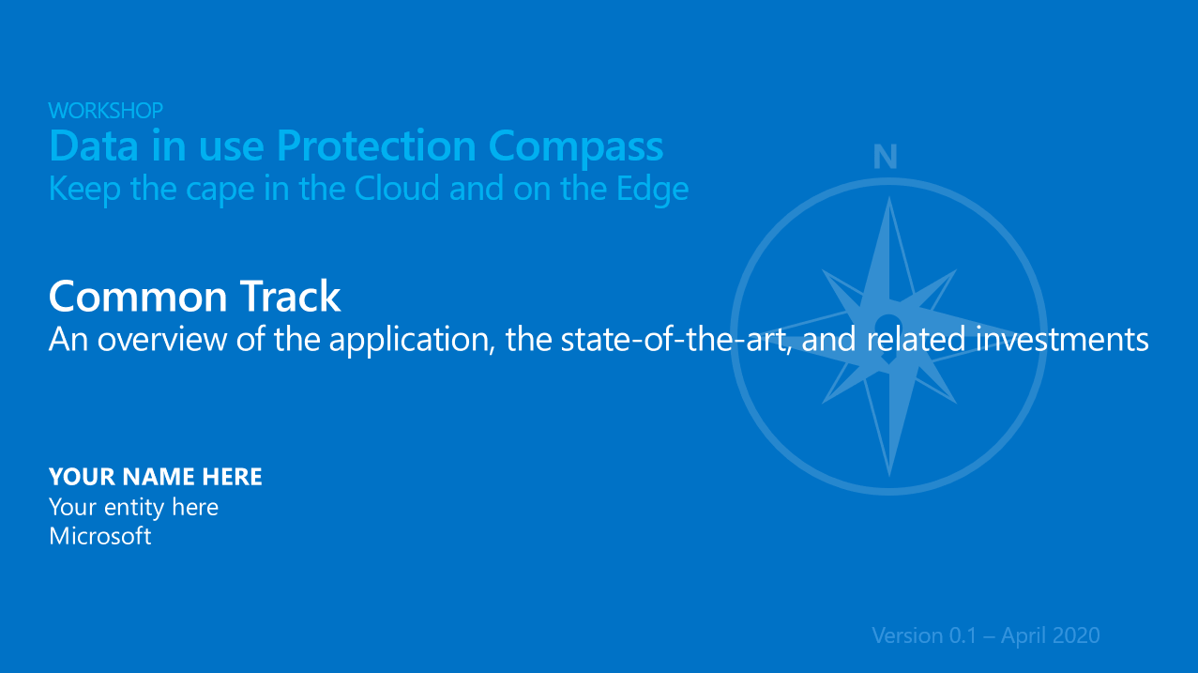
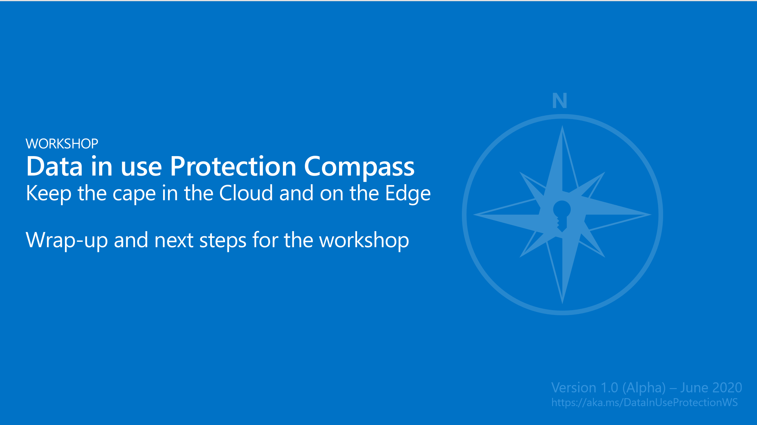
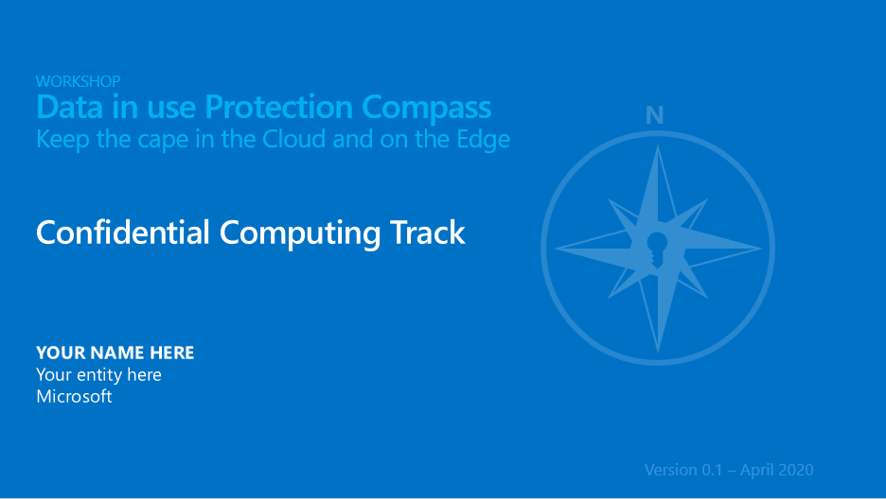
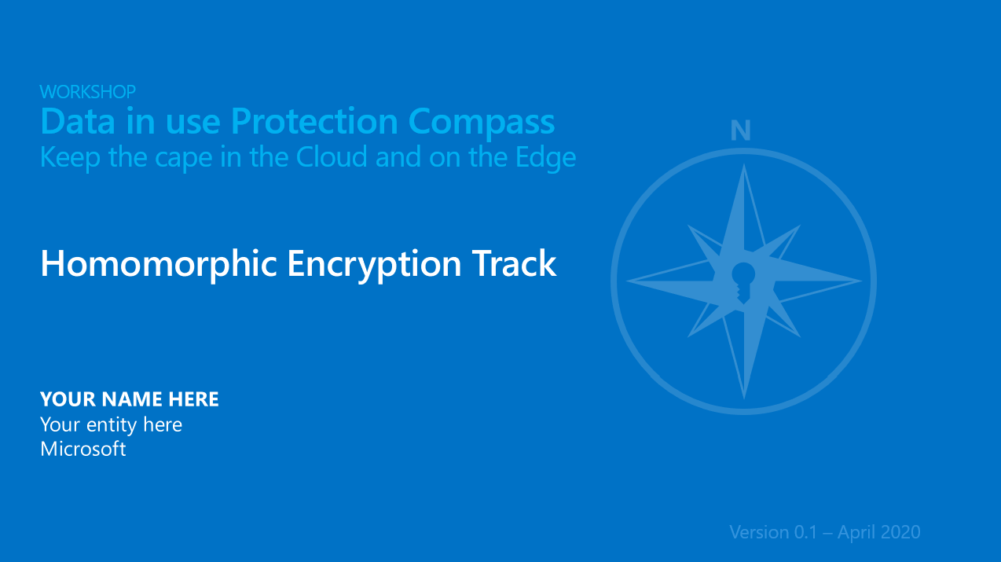
A compass for protecting your (most) sensitive data
A common track
A series of additional Specific tracks
Applicable techniques for data in use protection
Can serve as a guide to help inform on state-of-the-art and align specific investments, technical skills, and related toolchains to sustain your sensitive workloads in the Cloud and on the Edge
Guide decisions regarding the proper level of protection of your (most) sensitive data and/or the IP you most value
A Wrap-UP and SPECIFIC PERSPECTIVES
Confidential Computing Track
Homomorphic Encryption Track
+ Hands-On Labs
+ Hands-On Labs
Notes:
Important:
In order to make the presentation more dynamic and exciting, we are using Zoom for PowerPoint.
You can jump to and from specific slides, sections, and portions of the workshop in an order you decide while you're presenting.
For best results, use Office 365 and PowerPoint 2019.

Slide 6
N
Q&A

Slide 7

Thanks!

Slide 8


https://aka.ms/DataInUseProtectionWS
Attribution 4.0 International
(CC BY 4.0)
This presentation is shared under the license "Attribution 4.0 International (CC BY 4.0)". To see a copy of this license, visit https://creativecommons.org/licenses/by/4.0/legalcode or write to Creative Commons, PO Box 1866, Mountain View, CA 94042 USA

